Slide 1
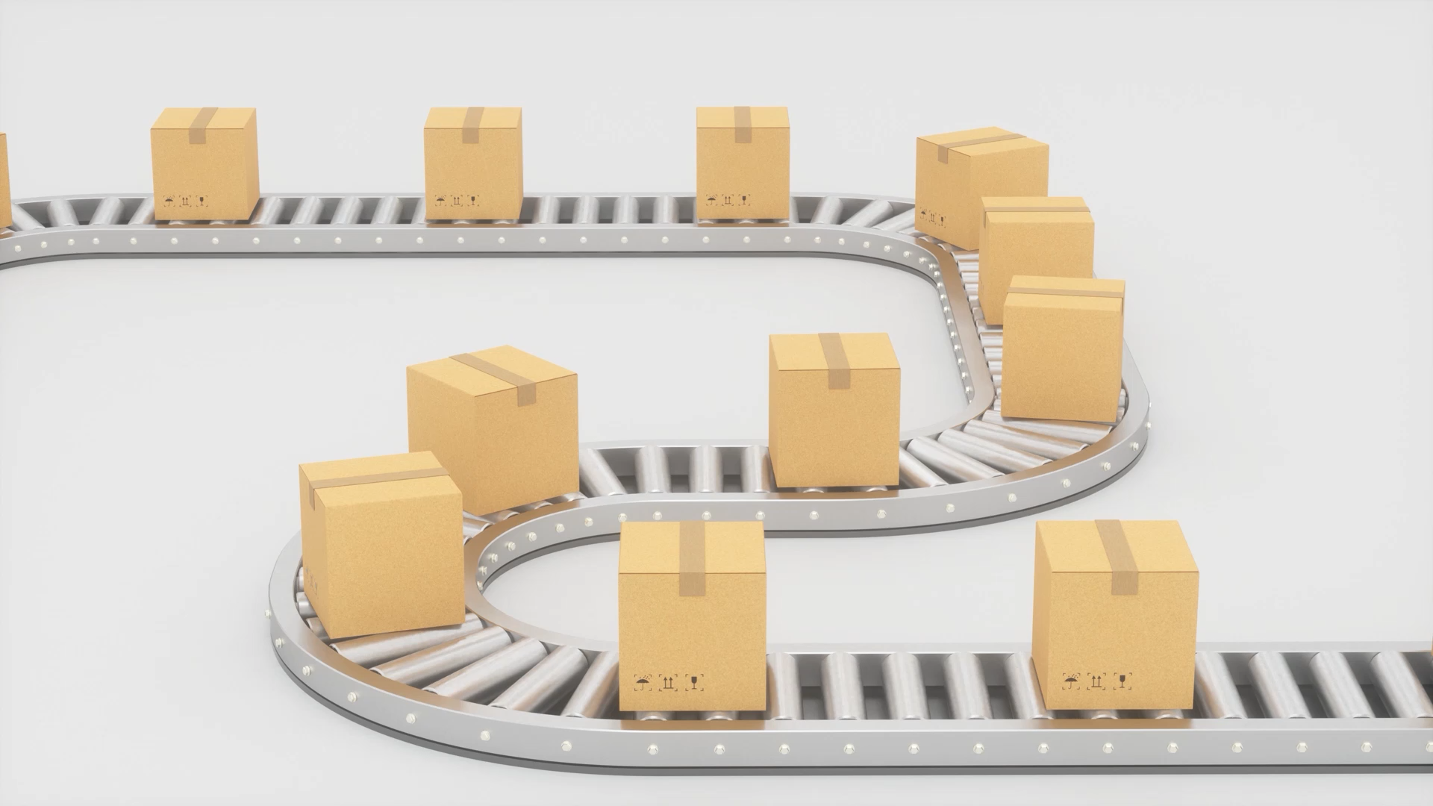
Make/Buy Analysis
Presented by Team 2 – G²
Chenchu Sakthi Charan Kondugari, Chad Tucker, Samrudh U P, Chenyu Yang

Slide 2
Agenda
Make/Buy Decisions
Machines
Factory
Overall Initial Capital Investments

Slide 3
IMPORTANCE OF COST ESTIMATION
The principal cost that are incurred in manufacturing a part or the entire product can be categorized into 3 main categories. Namely
Direct material cost
Direct labor cost
Overhead cost.

Slide 4
Current plan: Buy standard components (Heater, Battery, Spring and Coupler). All the other plastic components are manufactured in house. All the assembly is also done in house.
Assembly is broken down into two stages.
Assembly of the battery and heater onto one half of the shell.
Final stage of assembly. Assembly of trigger, glue stick, and all other miscellaneous components.
Estimated assembly cost for 50000 units- $13,900 (Assuming 45 units are assembled at each stage per hour)
Direct material cost (for 50000 units)- $8.91*50000=$445,500
Direct labor cost (for 50000 units)- $0.48*50000=$24,000.

Slide 5
Overhead Costs
Fabrication- 5% of direct labor cost = $1,200
Assembly- 10% of direct labor cost = $1,390
Additional equipment cost in fabrication = $20,000
Additional equipment cost in sub assembly = $20,000
Total cost of manufacturing = Direct material cost + Direct labor Cost + Overhead Cost.

Slide 6
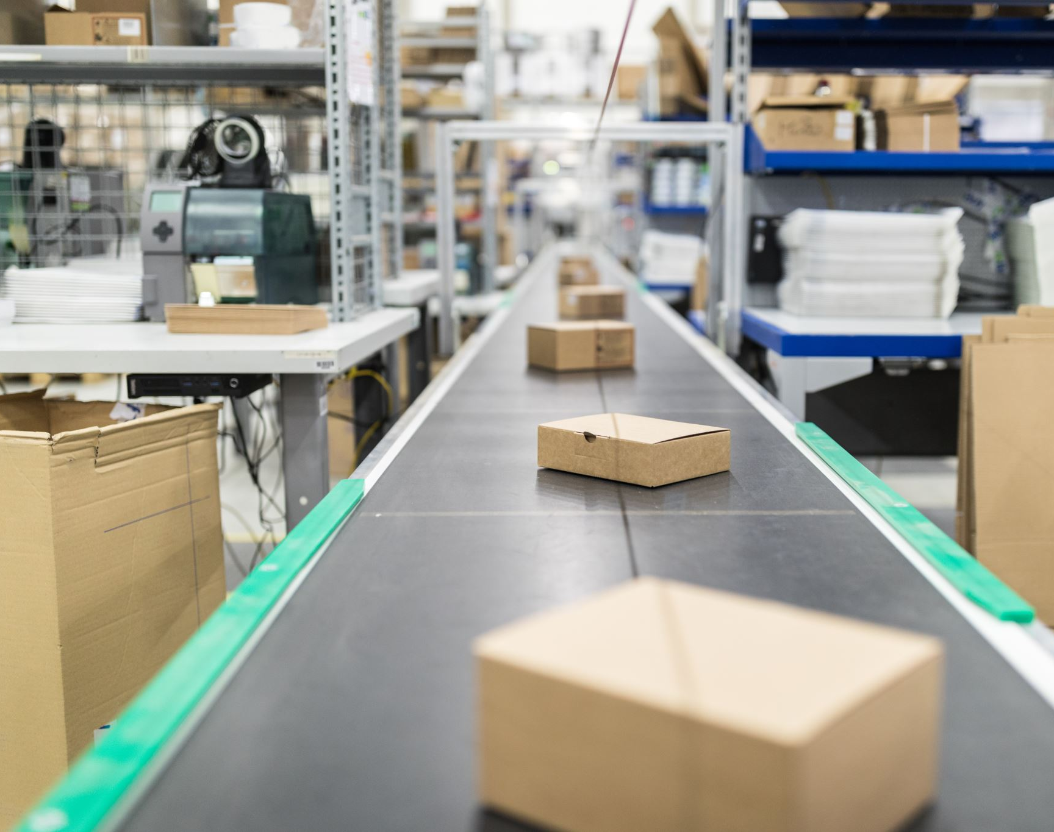
2. Machines for Manufacturing
In-house Processes
Manufacturing plastic components
ABS
Injection Molding Machine
Assembly line
Conveyor Belt

Slide 7
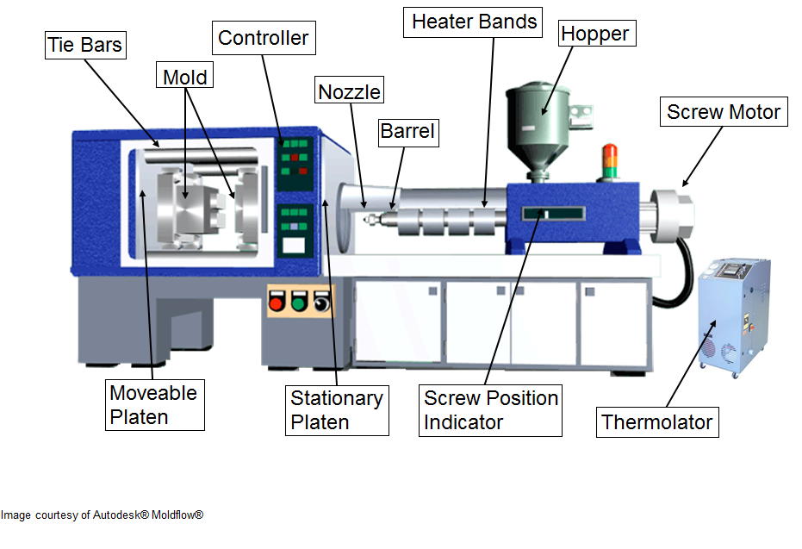
Injection Molding Machine
An injection molding machine is a machine for manufacturing plastic products by the injection molding process.
Plastic injection molding is a manufacturing process for producing parts by injecting molten material (thermoplastic and thermosetting polymers) into a mold. Material for the part is fed into a heated barrel, mixed, and injected into a mold cavity, where it cools and hardens to the configuration of the cavity.
Injection molding is widely used for manufacturing a variety of parts, from the smallest components to entire body panels of cars.

Slide 8
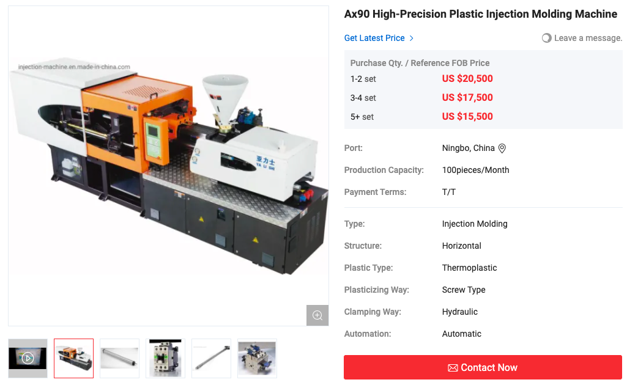

Part | # of units produced per lb. | Wastage per lb. | # of parts manufactured in one hour
Trigger | 20 | 10% | 200
Linkage | 40 | 10% | 250
Right side shell | 8 | 25% | 100
Left side shell | 8 | 25% | 100
Gripper | 12 | 10% | 200
Glue gripper | 15 | 15% | 250
PART | MATERIAL | AMOUNT (lb) | LIFE OF MOLD (# of pressing) | # of cavities
Trigger | ABS plastic | 0.03 | 125,000 | 4
Linkage | ABS plastic | 0.03 | 120,000 | 4
Right side shell | ABS plastic | 0.17 | 120,000 | 2
Left side shell | ABS plastic | 0.15 | / | /
Gripper | ABS plastic | 0.05 | 125,000 | 3
Glue gripper | ABS plastic | 0.01 | 125,000 | 4
Model | Capacity
AX-90B | 97g/s
https://injection-machine.en.made-in-china.com/product/vKoJUGHAIQfh/China-Ax90-High-Precision-Plastic-Injection-Molding-Machine.html

Slide 9
Summary of Manufactured Plastic Components
YR 1 & YR 2: (50,000 units)
Trigger: 278 hours; 13,889 pressing
Linkage: 223 hours; 13,889 pressing
Side Shells (Right & Left): 667 hours; 66,667 pressing
Gripper: 278 hours; 18,519 pressing
Glue Gripper: 236 hours; 14,706 pressing
YR 3 & YR 4: (60,000 units)
Trigger: 334 hours; 16,667 pressing
Linkage: 267 hours; 16,667 pressing
Side Shells (Right & Left): 800 hours; 80,000 pressing
Gripper: 334 hours; 22,223 pressing
Glue Gripper: 283 hours; 17,647 pressing
YR 5: (70,000 units)
Trigger: 389 hours; 19,445 pressing
Linkage: 312 hours; 19,445 pressing
Side Shells (Right & Left): 934 hours; 93,334 pressing
Gripper: 389 hours; 25,927 pressing
Glue Gripper: 330 hours; 20,589 pressing
3 Injection Molding Machines

Slide 10
AREA REQUIREMENTS
Production Areas:
Process | Equipment | Number | Dimensions ft | Area per unit Sq.ft | Total process area sq.ft
Extrude | Nanjing | 2 | 7x2.3 | 16.1 | 32.2
Mold | Ax90 | 3 | 11.7x4.1 | 50 | 150
Paint |  | 1 | 20x20 | 400 | 400
Lathe |  | 1 | 4x1.5 | 6 | 6
Bend | Bar bending machine | 1 | 3x3 | 9 | 9
Assembly |  | 1 | 20x40 | 800 | 800
Packaging |  | 1 | 20x30 | 600 | 600
 |  |  |  | Total | 1997
 |  |  |  | 50% aisles space | 999
 |  |  |  | Total area for production and assembly | 2996

Slide 11
NON-PRODUCTIVE AREAS:
Activity | Area sq.ft
Storage (raw material or finished goods?) | 215
Office | 430
Locker rooms | 270
Maintenance | 160
Tool crib | 160
Shipping and receiving (loaded or unloaded?) | 600
Total space required | 1,835
Total area needed: 2995.8+1835 = 4830.8 ft²
(Used Production centre method)

Slide 12
Overall Initial Capital Investments
Labor Rate for four months
Role | Quantity | Price per person | Total
Technician | 4 | $13,325 | $53,300
Office Manager | 1 | $13,750 | $13,750
Office Assistant | 1 | $11,675 | $11,675
Engineer | 1 | $26,600 | $26,600
 |  | Total | $105,325

Slide 13
Overall Initial Capital Investment
Property Expenses
 | Size ft² | Price per ft² | Price per month | Total
Office/Warehouse Space for lease | 4,830 | $0.58 | $2,817 | $11,269
Utility cost | 4,830 | $2.10 | $10,143 | $40,572
Property/Liability Insurance |  |  | $80 | $320
Building Maintenance |  |  | $150 | $600
 |  |  | Total | $52,761

Slide 14
Overall Initial Capital Investment
Raw Material Costs | Quantity for 4 months | price per unit | Total
Abs Plastic | 10,000lbs | 1.5lb | $15,000
Aluminum 6061 T6 rod | 695 12" rods | 9.15 per foot | $6,359
Steel rod | 5334 12" rods | 1.53 per foot | $8,161
COTS Costs | Quantity for 4 months | price per unit | Total
Spring | 16,667 | $2.38 | $39,667
Coupler | 16,667 | $1.30 | $21,667
Glue Gun heating element | 16,667 | $4.00 | $66,668
 |  | Total | $128,003

Slide 15
Overall Initial Capital Investment
Inventory= Amount needed for production + desired end inventory
Inventory
 | Amount needed for four months | Desired end inventory | Total Inventory | Total Price
Gripper | 16,667 | 111,333 | 128,000 | $57,600
Glue Gripper | 16,667 | 143,333 | 160,000
Trigger | 16,667 | 111,333 | 128,000
Linkage | 16,667 | 143,333 | 160,000
Right Side Shell | 16,667 | 47,333 | 64,000
Left Side Shell | 16,667 | 47,333 | 64,000
Tip | 16,667 | 47,333 | 64,000 | $24,400
Child Lock | 16,667 | 47,333 | 64,000 | $31,338
Spring | 16,667 | 47,333 | 64,000 | $152,320
Coupler | 16,667 | 47,333 | 64,000 | $83,200
Glue Gun Heating Element | 16,667 | 47,333 | 64,000 | $256,000
 |  |  | Total | $604,858

Slide 16
Overall Initial Capital Investment
Overall Investment | Cost
Labor Rate | $105,325
Rent/Utilities | $52,761
Raw Materials | $271,424
COTS Parts | $491,520
Cost of Machinery | $65,000
Total Investment Cost | $986,030

